Slide 1
Quick Reference Guide – Changes to BAMS Portal

Slide 2
Navigating to BAMS Portal Via Website
Practitioners can navigate to the BAMS Portal by clicking ‘Log-in to BAMS’ on the VBA Website

Slide 3
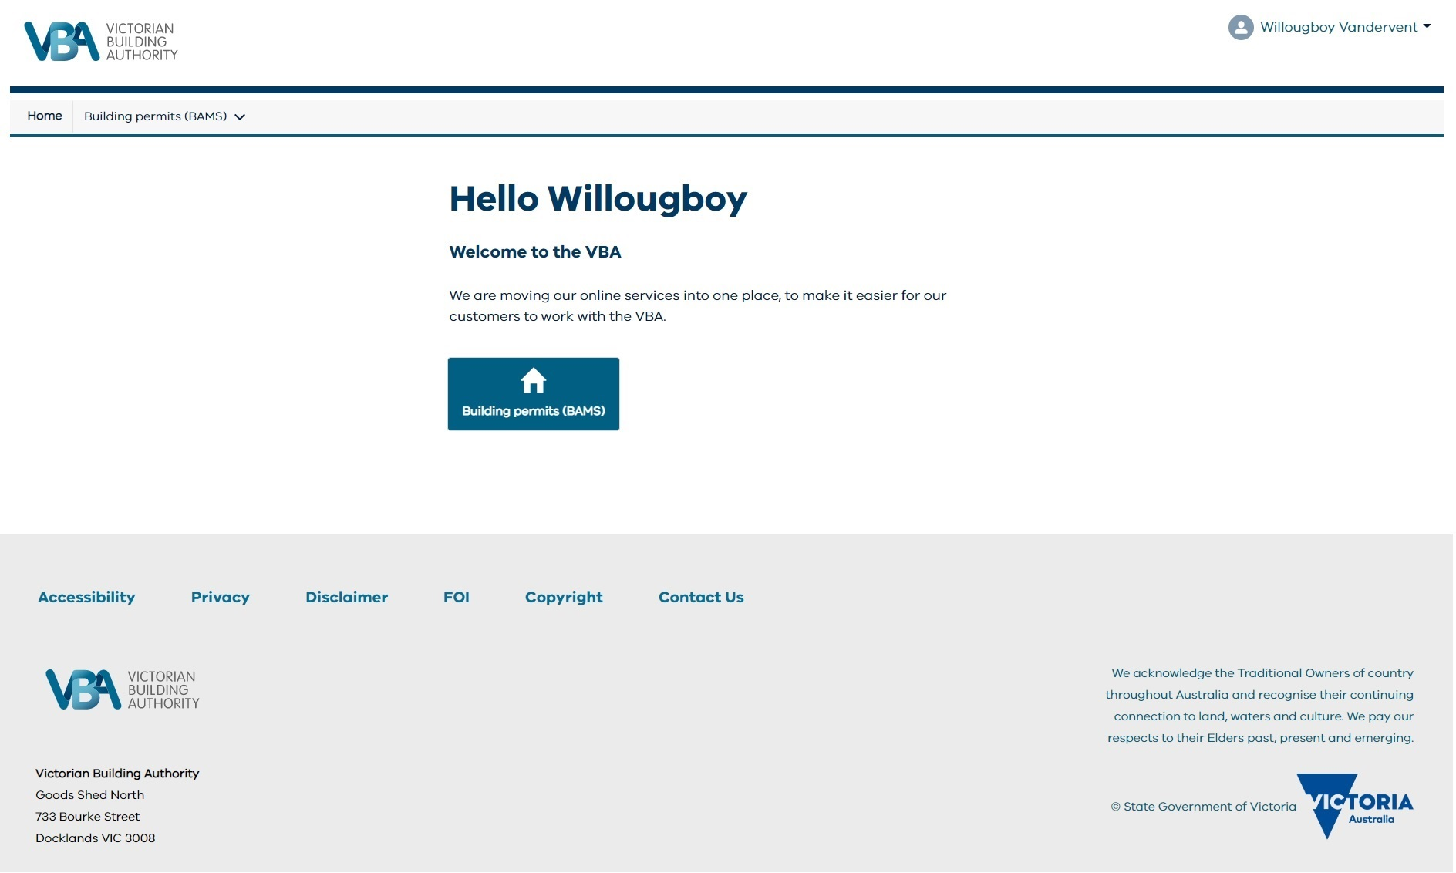
BAMS Portal Landing Page has a new design

Slide 4
Creation of new button for direct access to BAMS
A new button has been created that will take users directly to BAMS Pages

Slide 5
There is new Navigation Menu
Horizontal navigation ribbon has been collapsed and presented as a vertical drop-down menu

Slide 6
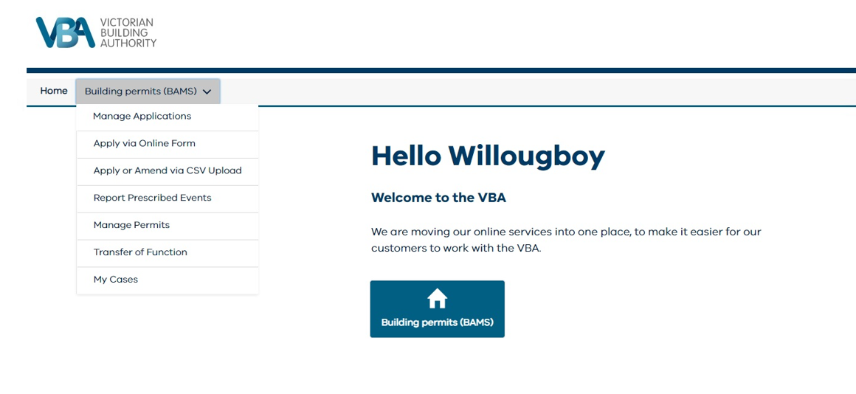
The Navigation Menu has drop down options
Dropdown menu will take users to the selected pages within BAMS eg: Manage Applications

Slide 7
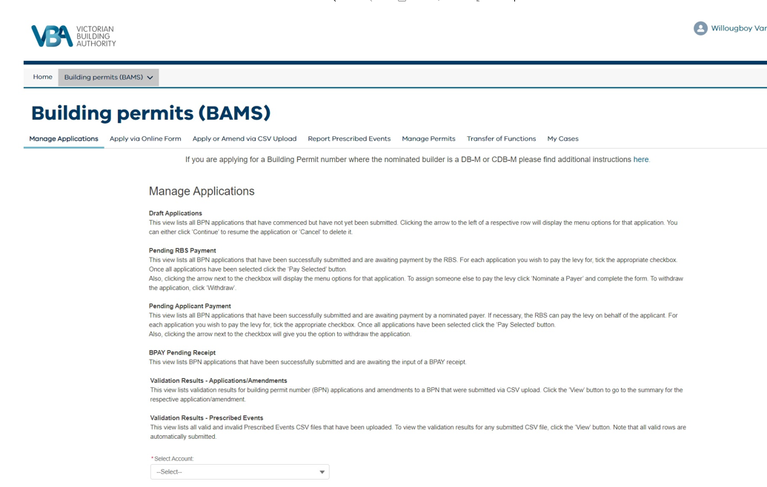
Manage Applications Page
From either the BAMS button or the drop down menu, users can transact on the pages as they would normally.
There has not been any changes made to BAMS functionality.

